Slide 1





.NET Conf 2024 MSDEVMTL
Anthony Giretti
http://anthonygiretti.com
https://github.com/AnthonyGiretti
https://www.linkedin.com/in/anthony-g-98670426/
Notes:
© Microsoft Corporation. All rights reserved. MICROSOFT MAKES NO WARRANTIES, EXPRESS, IMPLIED OR STATUTORY, AS TO THE INFORMATION IN THIS PRESENTATION.
12/17/2024 2:19 PM
1

Slide 2

Get .NET 9
Download .NET 9 aka.ms/get-dotnet-9
Notes:
2

Slide 3
.NET 9
Agenda
ASP.NET Core 9

Slide 4
.NET 9

Slide 5
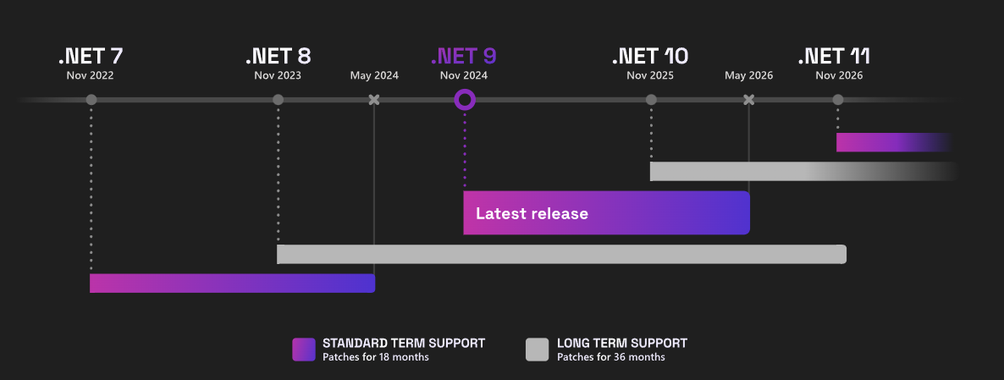
Roadmap

Slide 6
Performance improvements
15 % faster startup
10 % less memory consumption
40 % faster cold launches
Lower CPU usage
GC Improvements
Native AOT
25 % reduction on latency
20 % more Http Request handling
35 % faster on JSON Serialization
Http Requests
System.Text.Json

Slide 7
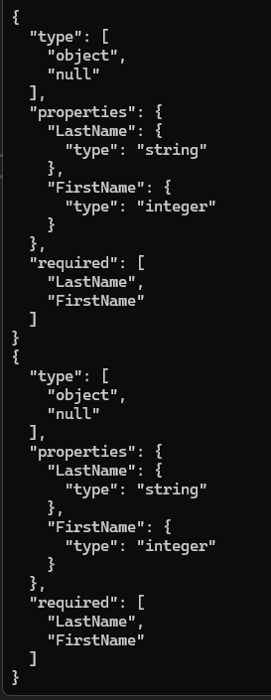
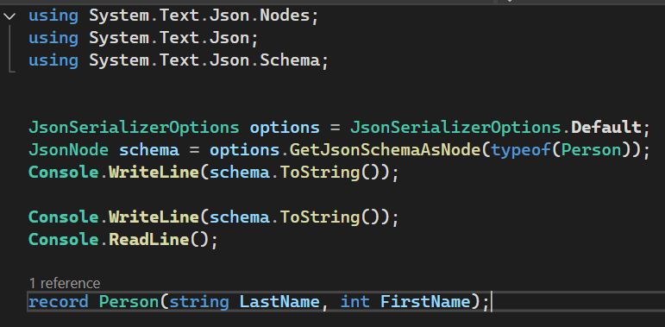
System.Text.Json
Json Schema Exporter

Slide 8
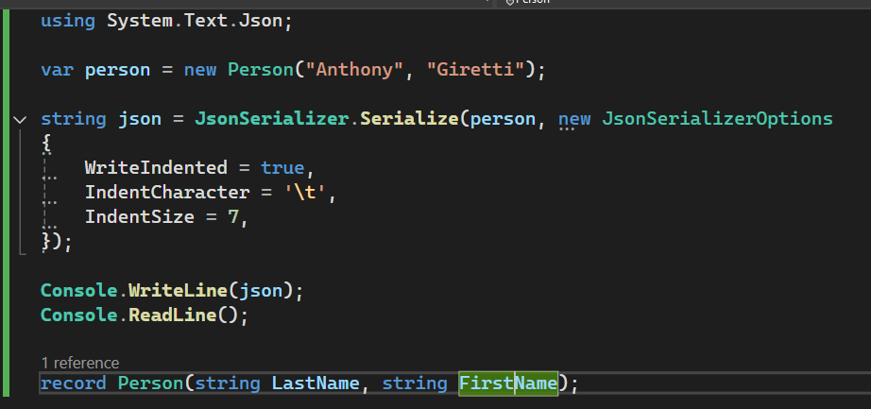
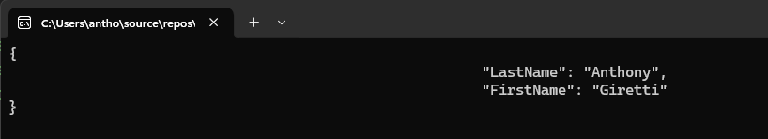
System.Text.Json
Custom Indentation

Slide 9
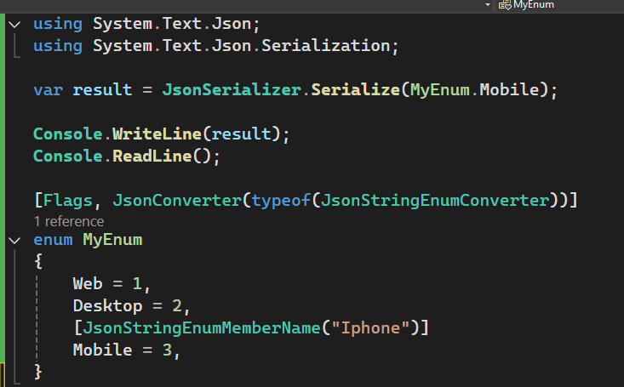
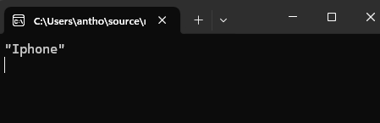
System.Text.Json
Enum customization

Slide 10
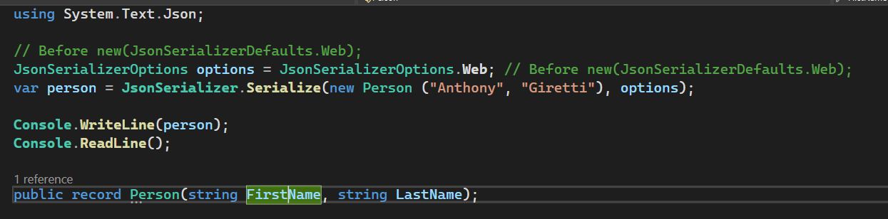
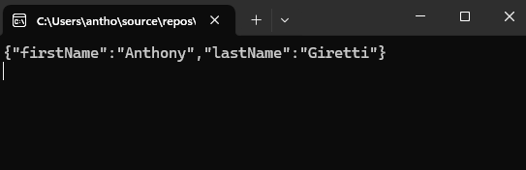
System.Text.Json
Singleton options
Ease of use for default serialization
Performance

Slide 11
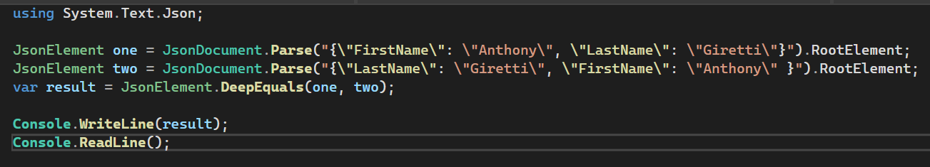
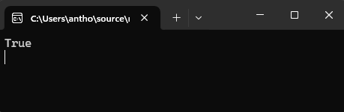
System.Text.Json
Singleton options

Slide 12
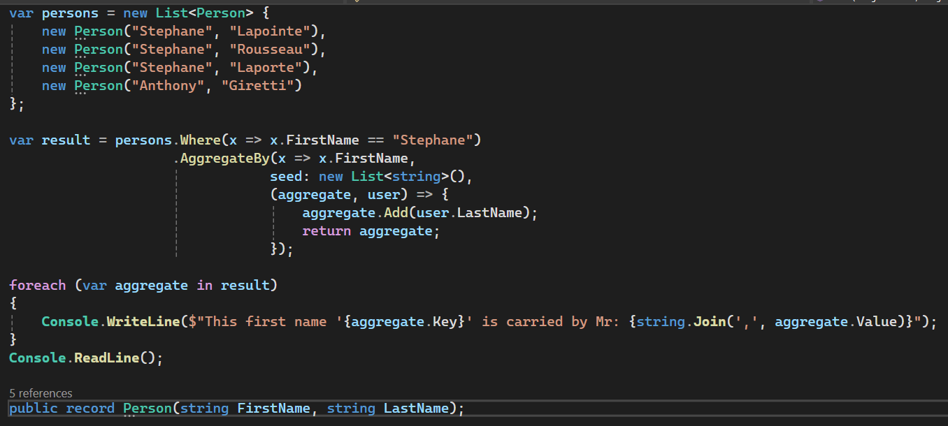
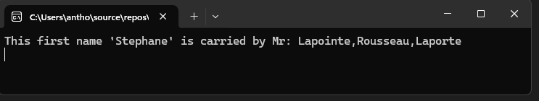
Linq
AggregateBy

Slide 13
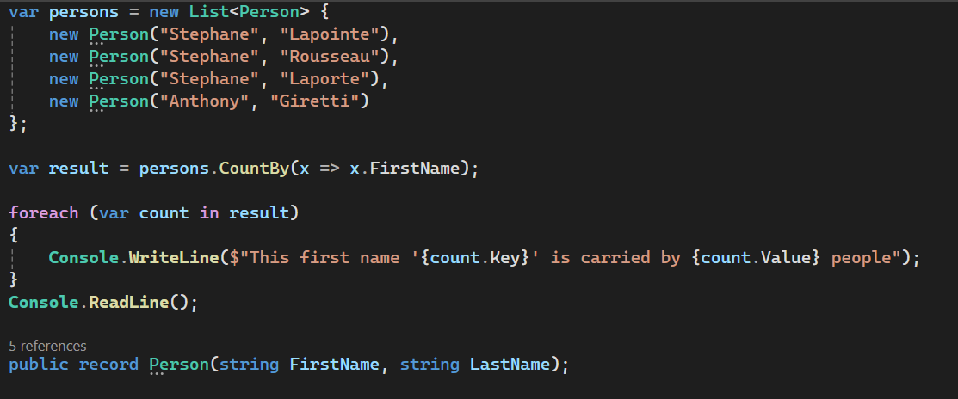
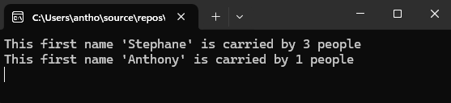
Linq
CountBy

Slide 14
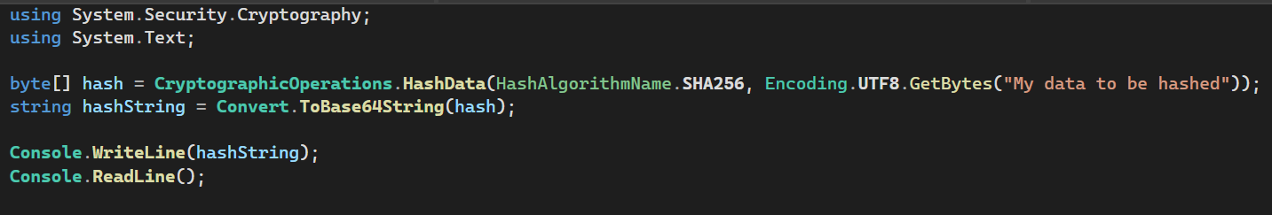
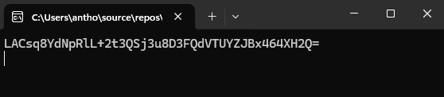
Cryptography
New HashData function
Simpler hashing

Slide 15
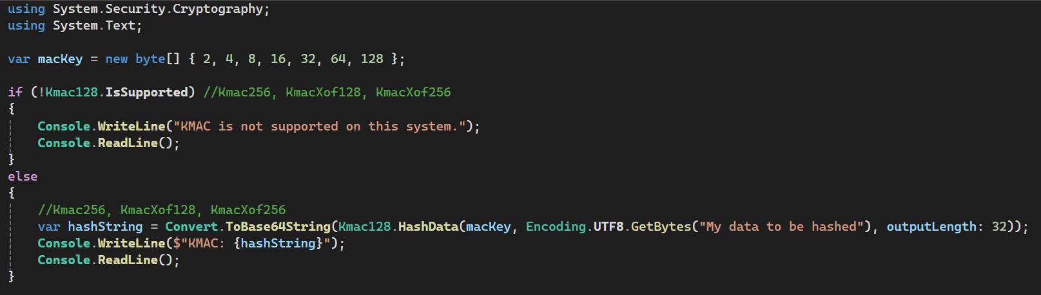
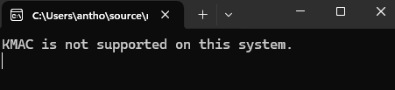
Cryptography
KMAC Algorithms
Requires Windows 11 Build 26016 or later / Linux requires OpenSSL 3.0 or later

Slide 16
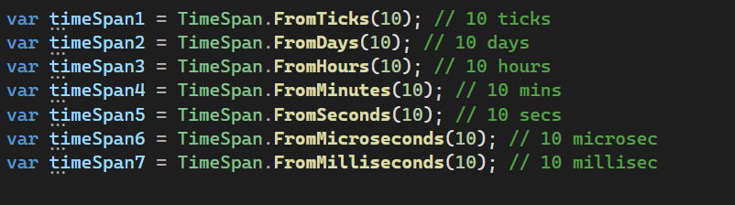
TimeSpan
New overrides for From*

Slide 17
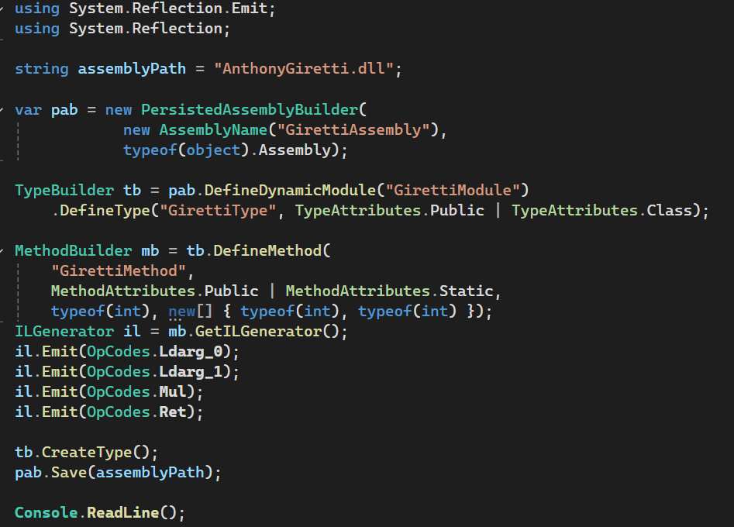
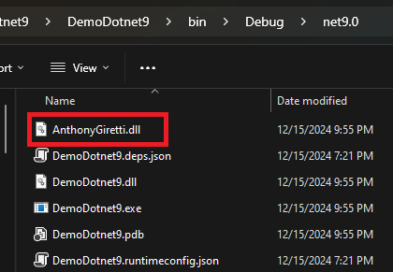
Reflection
Persisting Assembly creation

Slide 18
ASP.NET Core 9

Slide 19
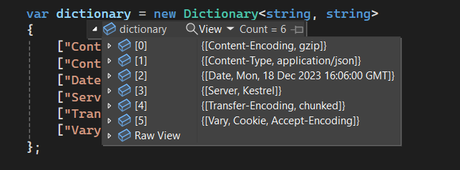
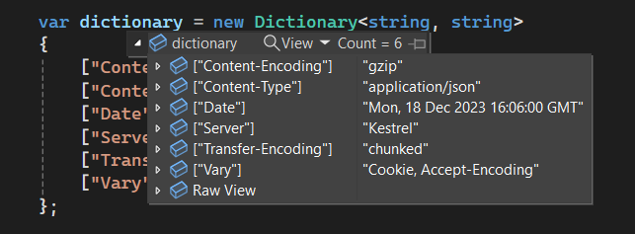
Debugging
Dictionary improvements

Slide 20
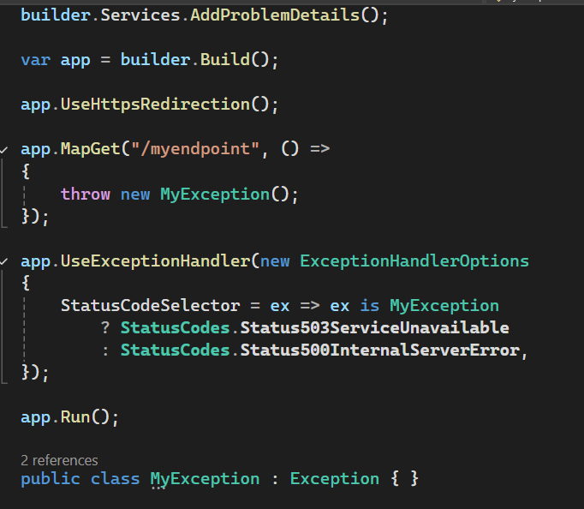
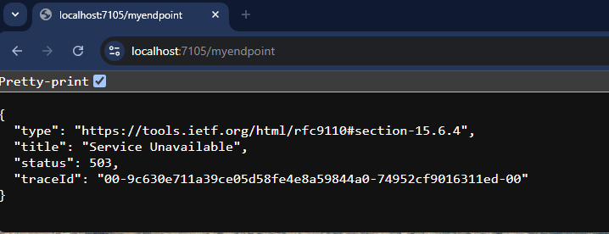
Error handling
ExceptionHandlerOptions class

Slide 21
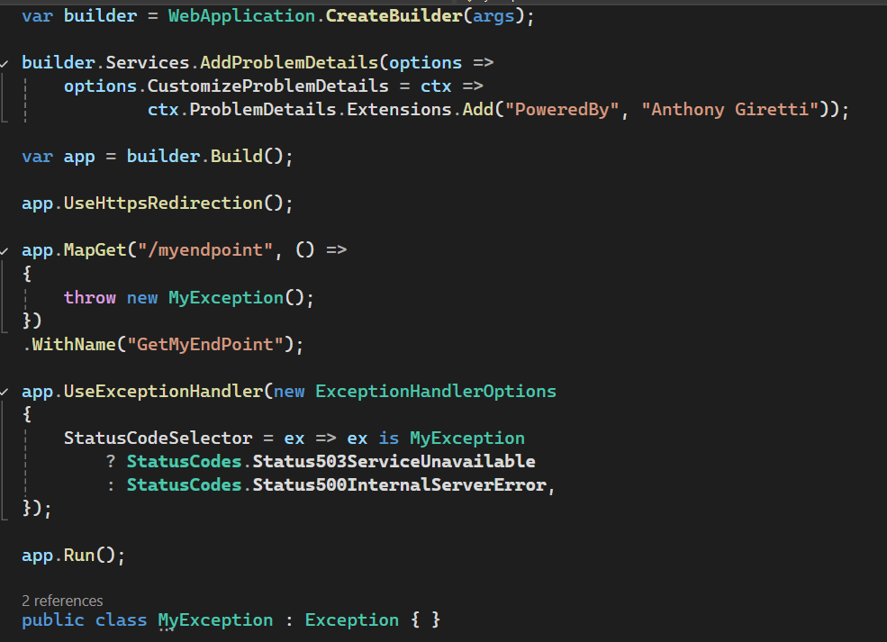
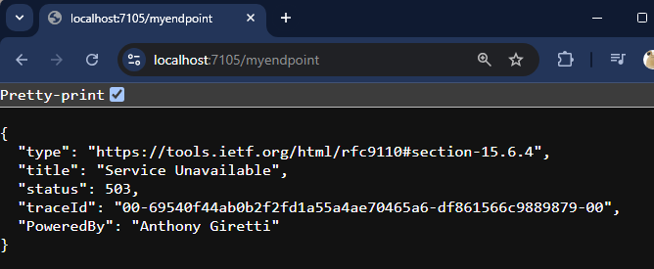
Error handling
ProblemDetails customization

Slide 22
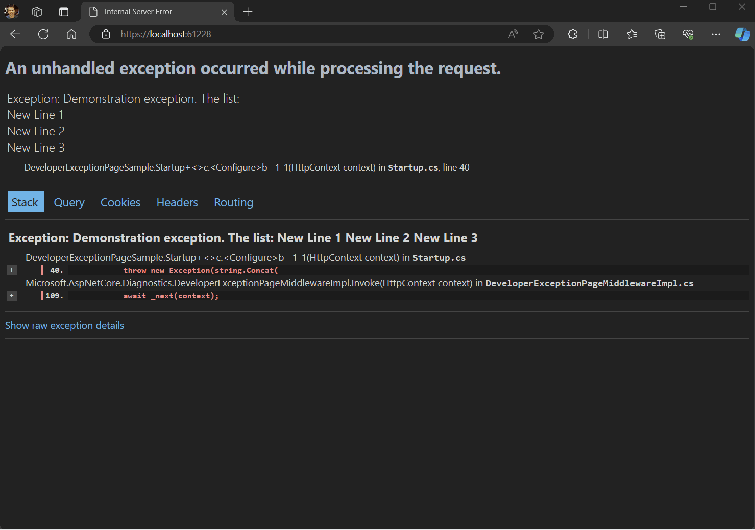
Error handling
Developer exception page

Slide 23
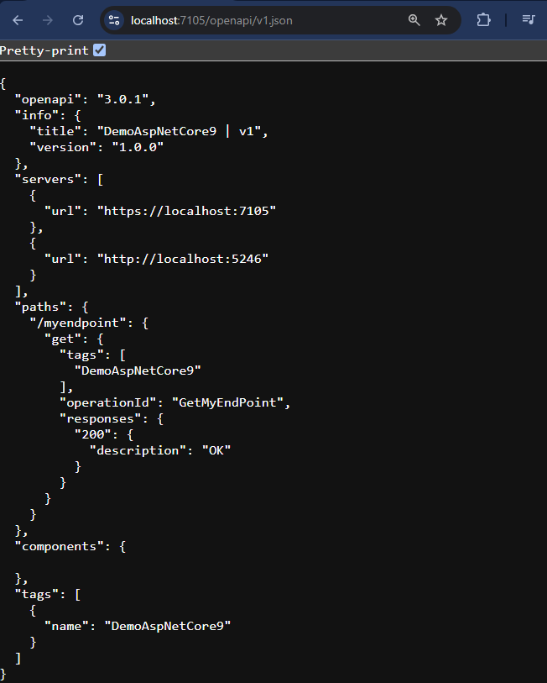
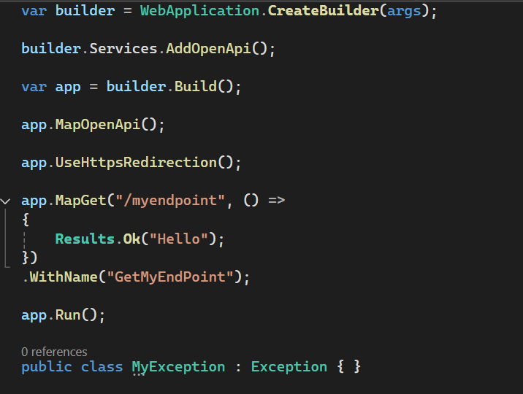
OpenAPI
No more SwashBuckle!

Slide 24
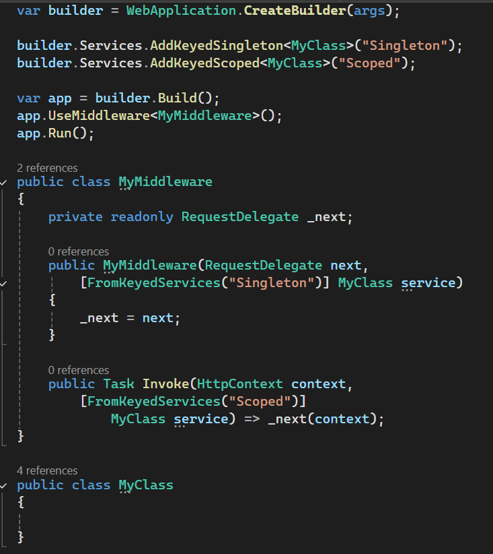
MiddleWares
Available Keyed DI

Slide 25
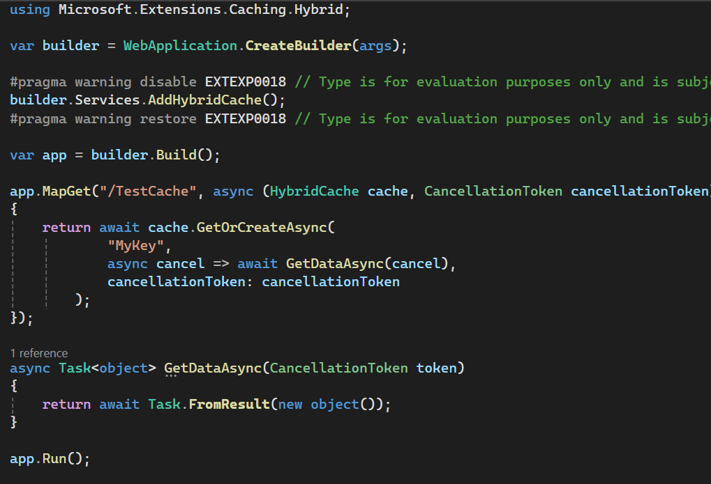
Hybrid cache
Wrapper of IDistributed caching and IMemoryCache

Slide 26
Thank you

Slide 27

Ensure slide content is accessible
CONTRAST
Use high contrast colors for maximum readability.
The recommended contrast ratio is at least 4.5:1.
SHAPE AND COLOR
Use different shapes with a legend to indicate statuses to accommodate for color blindness.
Example:
ALT TEXT
Alt text helps people with screen readers understand the content of slides.
You should create alternative text for shapes, pictures, charts, tables, SmartArt graphics, or other objects.
Here’s how:
Right click on item.
Select Edit Alt Text.
Enter a Description.
If an object is meant to add visual styling and doesn’t contain meaning (e.g., stylistic borders), do not add alt text and instead check “Mark as decorative.”
SLIDE LAYOUTS
Using a built-in slide layout that matches your content ensures a hierarchical reading order of text blocks.
Example:
If a new slide will have a title, rather than starting with a blank layout and adding a text block for the title, choose one of the built-in layouts with a title placeholder.
READING ORDER
Screen readers describe content on the screen in the order it was created.
To ensure your content is read back in the order you prefer, arrange your objects in the Selection Pane appropriately. Objects on the bottom of the selection pane are read first.
Here’s how:
Click the Home tab.
In the Drawing group, select the Arrange drop-down menu.
Click Selection Pane…
Subject 1
Color Contrast Analyzer
Download this tool to determine the legibility of text and the contrast of visual elements.
Subject 2
Subject 3
Download
C1
C2
C3
ADDITIONAL TIPS
Be sure to run the Accessibility Checker! Go to File click the Check for Issues drop down menu click Check Accessibility.
Videos need to be accessible: If your presentation includes a video, ensure it is captioned and audio described (if appropriate).
Visit the Office Accessibility Center to learn more about accessibility in PowerPoint.
Notes:
© Microsoft Corporation. All rights reserved. MICROSOFT MAKES NO WARRANTIES, EXPRESS, IMPLIED OR STATUTORY, AS TO THE INFORMATION IN THIS PRESENTATION.
12/17/2024 2:19 PM
27

